Slide 1
RECAP
Last Session

Slide 2
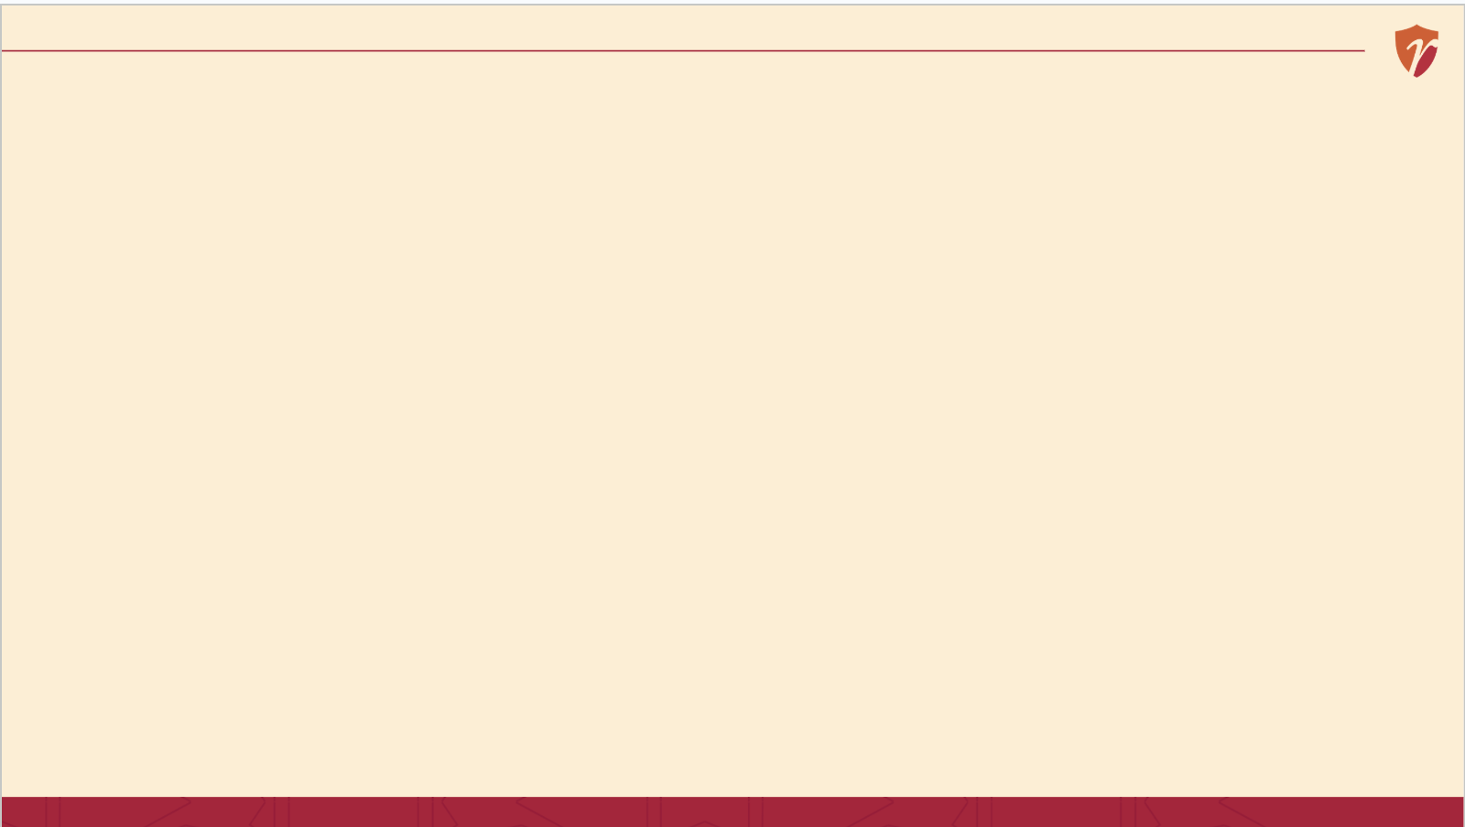
RECAP
Last Session, in 60 Seconds
Good strategy involves real trade-offs deliberately choosing what NOT to do
Strategy must fit both the outside environment and your own capabilities
Execution matters as much as the plan itself often more
Today: the actual process strategy follows, from idea to result.
4 / 15

Slide 3
CORE CONCEPT 1
The Strategic Management Model: Four Stages

Slide 4
CORE CONCEPT 1
The Strategic Management Model: Four Stages
1
2
3
4
Planning
Formulation
Implementation
Evaluation
Look outward and inward before deciding anything
Design the actual strategy
Put the strategy into action
Check if it's working, and adjust
It's a cycle, not a straight line — evaluation often sends you back to scanning again.
Framework based on: A. Nag, Strategic Management: Analysis, Implementation and Control, Ch. 1.
6 / 15

Slide 5
A STORY TO START
How Boncho Actually Decided to Add Delivery
She noticed something
Rainy days meant fewer customers walking to her cart, but her friends kept asking if she delivered.
She thought it through
Could afford a delivery bag and a bit of extra staff time? Would nearby hostels actually order enough to be worth it?
She tried it, then watched closely
She started with just two hostels, tracked orders weekly, and only expanded once it was clearly working.
Without knowing it, Priya just walked through all four stages of the strategic management model.
“Priya's Momos” is a fictional business created for classroom illustration only.
5 / 15

Slide 6
STAGE 1 OF 4
Planning
Looking outward and inward before making any big decision.
Outward: what are customers, competitors, and the broader market doing? Inward: what can we actually afford, staff, and support well?
For Boncho
Noticing rainy-day drop-offs and repeated delivery requests — that's scanning in action.
Based on: A. Nag, Strategic Management: Analysis, Implementation and Control, Ch. 1.
7 / 15

Slide 7
STAGE 2 OF 4
Strategy Formulation
Designing the actual response turning what you learned into a real choice.
This is where you weigh options, consider trade-offs, and commit to one direction over the alternatives.
For Boncho
Deciding to test delivery with just two nearby hostels first, instead of the whole neighbourhood at once.
Based on: A. Nag, Strategic Management: Analysis, Implementation and Control, Ch. 1.
8 / 15

Slide 8
STAGE 3 OF 4
Strategy Implementation
Putting the plan into action where most of the real work actually happens.
This is where the policies, programs, procedures and budgets we learned last week come to life the tools that make a strategy actually run day to day.
For Boncho
Buying a delivery bag, telling regulars, and actually running orders for two weeks.
Based on: A. Nag, Strategic Management: Analysis, Implementation and Control, Ch. 1.
9 / 15

Slide 9
STAGE 4 OF 4
Evaluation & Control
Checking whether it's actually working and being willing to change course.
Without this stage, a business keeps doing something long after it's stopped working. This stage often sends you straight back to scanning again.
For Broncho
Tracking weekly delivery orders — and only expanding to more hostels once the numbers clearly justified it.
Based on: A. Nag, Strategic Management: Analysis, Implementation and Control, Ch. 1.
10 / 15

Slide 10
LOOKING AHEAD
Introducing the Three Levels of Strategic Management
Corporate
SBU / Business
Functional
Which businesses should we even be in?
How do we win within one specific business?
How does each department support that win?
We'll dig into each of these deeply next session.
Framework based on: A. Nag, Strategic Management: Analysis, Implementation and Control, Ch. 1.
11 / 15

Slide 11
BACK TO PRIYA'S MOMOS
Her Delivery Decision, All Four Stages
Planning
Noticed rain drop-offs and delivery requests
Formulation
Chose to test with 2 hostels, not the whole area
Implementation
Bought a delivery bag, ran it for 2 weeks
Evaluation
Tracked orders, then expanded once it worked
“Priya's Momos” is a fictional business created for classroom illustration only.
12 / 15

Slide 12
SUMMARY
Key Takeaways from Today
The strategic management model has four stages: scan, formulate, implement, evaluate
It's a cycle, not a straight line — evaluation often restarts the process
Even Priya's small delivery decision followed all four stages
Strategy exists at three levels: corporate, SBU, and functional — our focus next session
13 / 15

Slide 13
REFLECT
One-Minute Self-Check
Can I name all four stages of the strategic management model, in order?
Can I explain why evaluation often leads back to scanning?
Can I think of a small decision I've made recently that followed this same cycle?
14 / 15

Slide 14
REFERENCES & NEXT SESSION
Sources & What's Coming Up
Required Reading
Coming Up — Session 8
A. Nag — Strategic Management: Analysis, Implementation and Control, Ch. 1
Corporate, SBU & Functional Strategy
Further Resources
A close look at the three levels, using one giant Indian conglomerate.
Wheelen, T.L. & Hunger, J.D. — Strategic Management and Business Policy
Kazmi, A. — Business Policy and Strategic Management
No prep needed — just come curious.
15 / 15

